Slide 1




Maximum Likelihood: The theoretical basis for our objective functions
Garrison W. Cottrell
Gary's Unbelievable Research Unit (GURU)
Computer Science and Engineering Department
Temporal Dynamics of Learning Center
Institute for Neural Computation
UCSD

Slide 2
Reading
This lecture is based on Bishop Chapter 6, sections 6.1, 6.7, and 6.9.

Slide 3
This lecture
What is maximum likelihood?
How does it lead to Sum Squared Error for regression?
How does it lead to cross-entropy for logistic regression?
How does it lead to cross-entropy for multinomial regression?
Next lecture: Other approaches to objective functions
Summary

Slide 4
This lecture
What is maximum likelihood?
How does it lead to Sum Squared Error for regression?
How does it lead to cross-entropy for logistic regression?
How does it lead to cross-entropy for multinomial regression?

Slide 5

Maximum Likelihood
Main Idea:
What we really want to know is, given the data D, which parameters W of our model are most likely?
That is, we want the parameters W that maximize P(W|D).
This is hard.
But recall Bayes’ Rule:

Slide 6

Maximum Likelihood
Recall Bayes’ Rule:
Note that:
The probability of the data is just a normalizing constant.
We have no reason, a priori, to assume some W’s are better than others, so we assume that without any data, the prior is flat – all W’s are equally likely.
So P(W), the prior, is a constant.

Slide 7

Maximum Likelihood
So, given the assumption of a uniform prior:
Hence the name, Maximum Likelihood.
Specifically, we want our network to make the observed data as likely as possible.
How we model the distribution of the data is key.

Slide 8
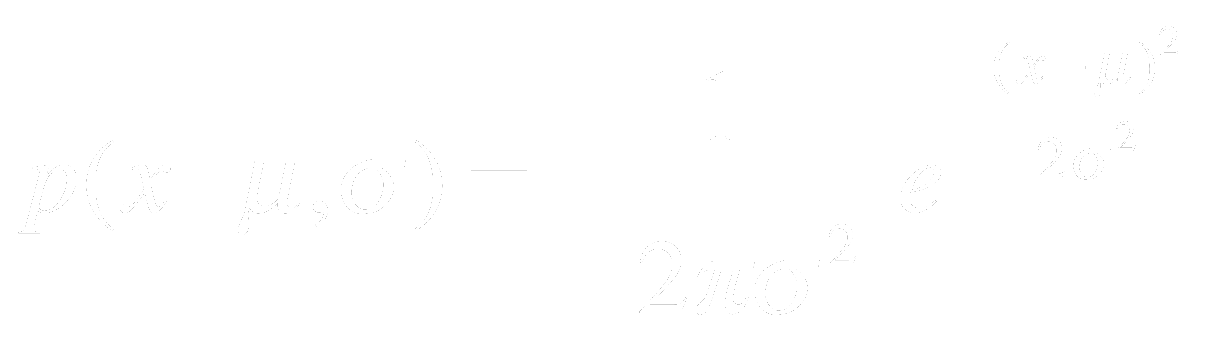
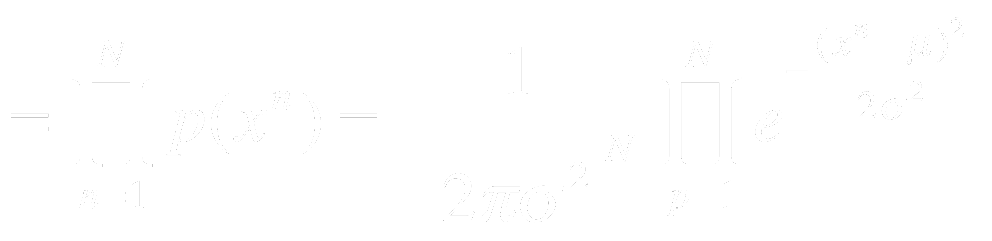
Maximum Likelihood
Example: Gaussian distributions
Now, assuming the data points are independently identically distributed (iid), the Likelihood of the data is:
L

Slide 9

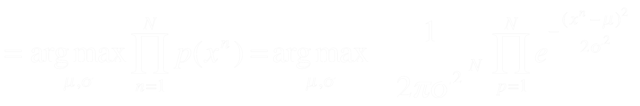
Maximum Likelihood
Finally, Maximum Likelihood says we should pick μ and σ such that:
Again, in English: We should choose the parameters that maximize the likelihood of the data.
How do we do that?
L
Notes:
Take the derivative with respect to each parameter and set = 0, and solve.

Slide 10
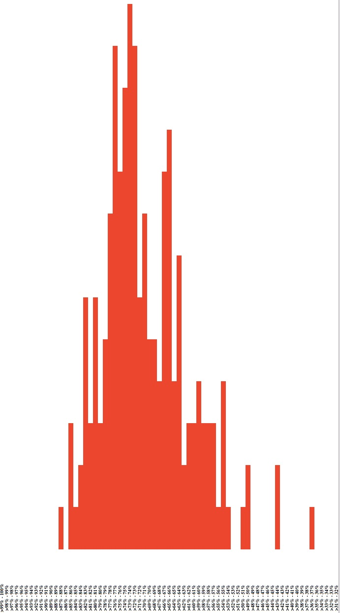
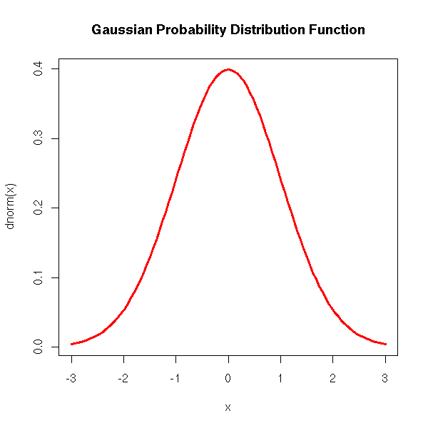

Maximum Likelihood
Does this Gaussian make the data likely?
CSE 150
Grades
Spring 2016
Suppose we have some grades from a class:

Slide 11
Maximum Likelihood
How about this one?
CSE 150
Grades
Spring 2016
Suppose we have some grades from a class:

Slide 12
Maximum Likelihood
How about this one?
CSE 150
Grades
Spring 2016
Suppose we have some grades from a class:

Slide 13
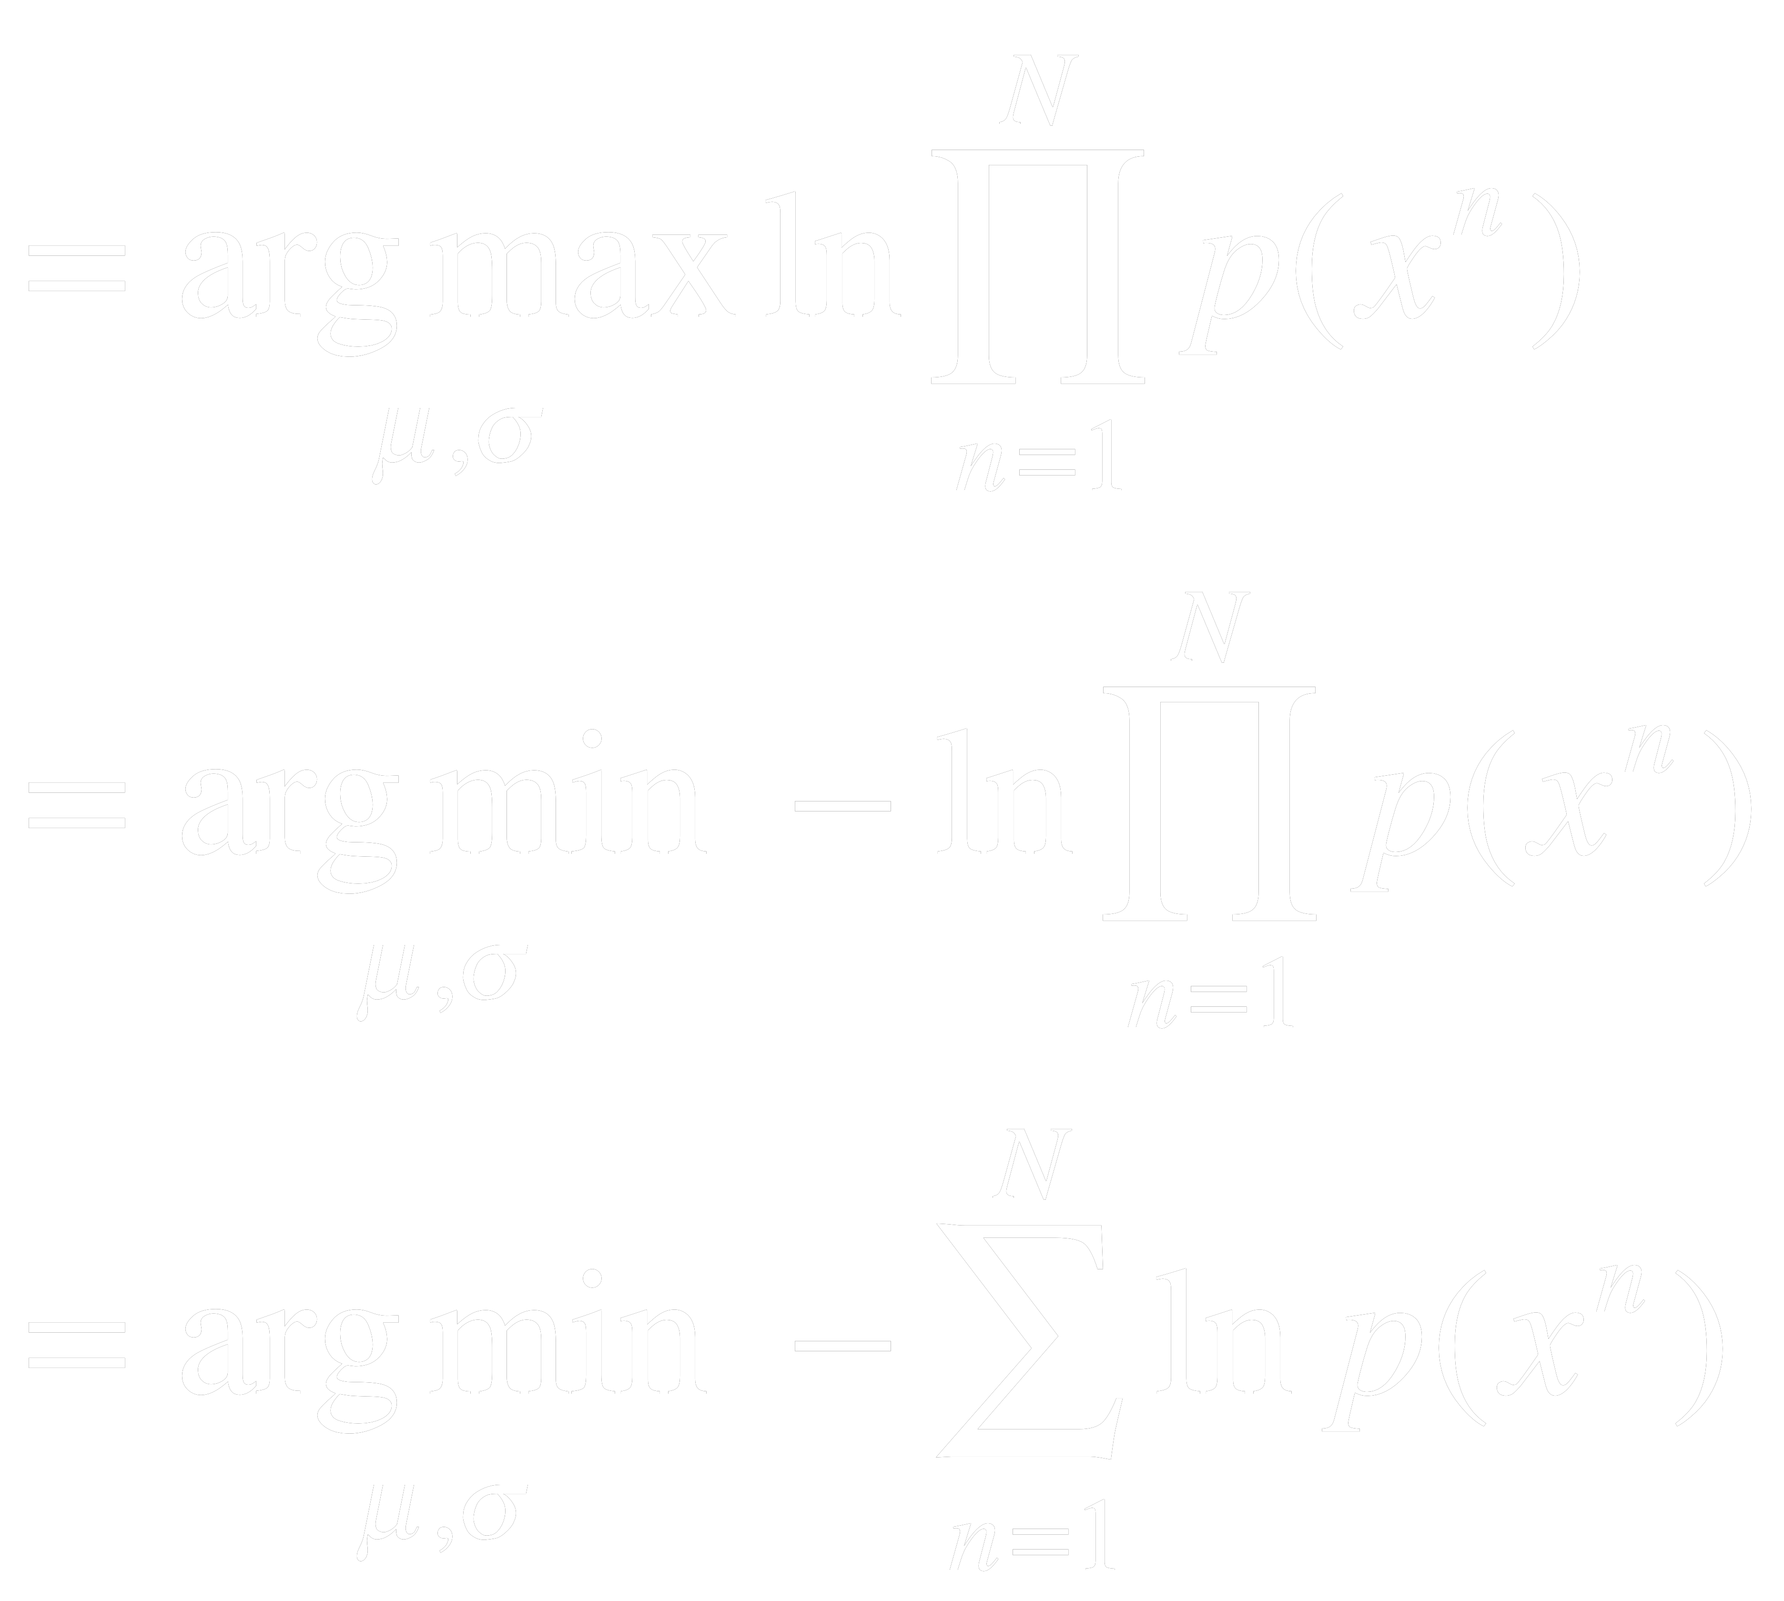
How do we find the ML parameters?
Usually, it is easier to minimize the negative log likelihood, i.e.,
L

Slide 14
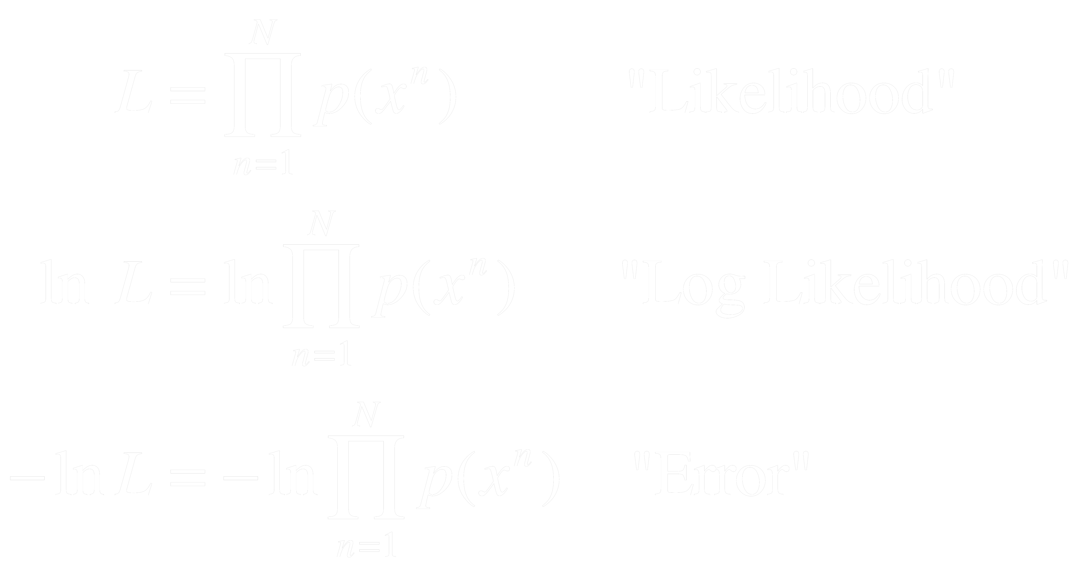
How do we find the ML parameters?
First, a little terminology:
The negative log likelihood is called the error.

Slide 15

How do we find the ML parameters?
These are all equivalent:
Where the last bit assumes a gaussian

Slide 16
How do we find the ML parameters?
These are all equivalent:
Exercise for the reader: Show that this leads to setting μ to the empirical mean!

Slide 17
How do we find the ML parameters?
Exercise for the reader: Show that this leads to setting μ to the empirical mean!
Hint: take the derivative with respect to μ, set it to zero, and solve.

Slide 18
Clicker time!
Q1: Maximum Likelihood Estimation
a. Maximizes parameters of a distribution
b. Maximizes the loss function
c. Maximizes the probability of the data
d. Maximizes the log likelihood of the loss
e. Minimizes the probability of the data
Notes:
answer: c

Slide 19
Clicker time!
Q1: Maximum Likelihood Estimation
a. Maximizes parameters of a distribution
b. Maximizes the loss function
c. Maximizes the probability of the data
d. Maximizes the log likelihood of the loss
e. Minimizes the probability of the data
Notes:
answer: c

Slide 20
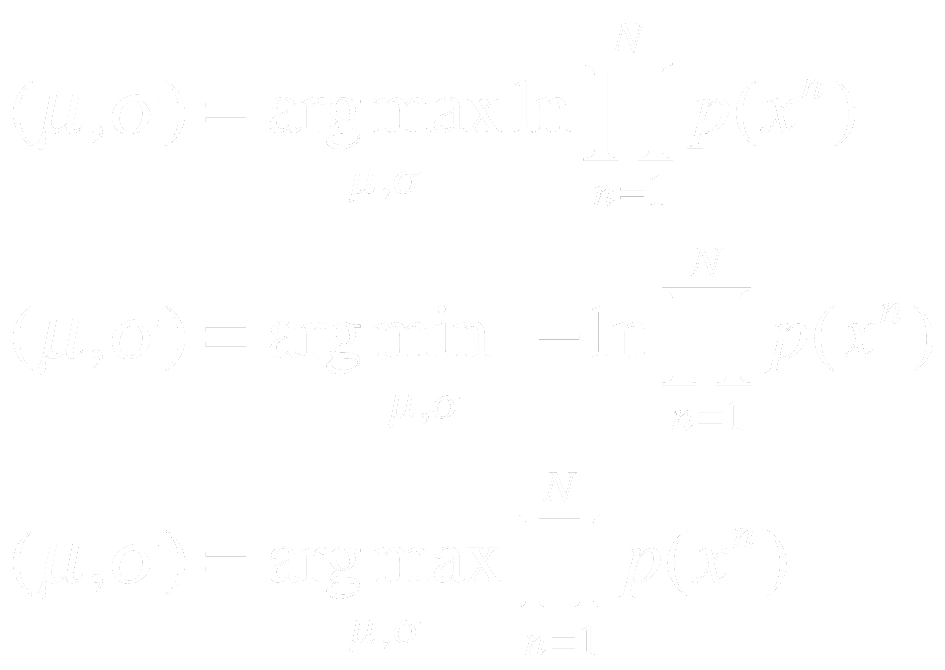
Clicker time!
Q2: The following is an expression for the results of MLE for a one-D Gaussian:
A.
B.
C.
D. A & C
E. You can’t fool me, these are all the same!
Notes:
answer: c

Slide 21
Clicker time!
Q2: The following is an expression for the results of MLE for a one-D Gaussian:
A.
B.
C.
D. A & C
E. You can’t fool me, these are all the same!
Notes:
answer: c

Slide 22
This lecture
What is maximum likelihood?
How does it lead to Sum Squared Error for regression?
How does it lead to cross-entropy for logistic regression?
How does it lead to cross-entropy for multinomial regression?

Slide 23
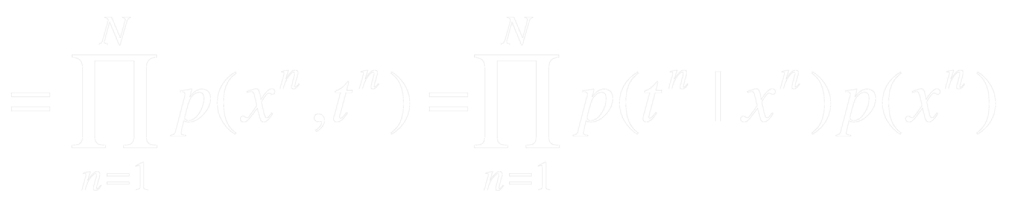
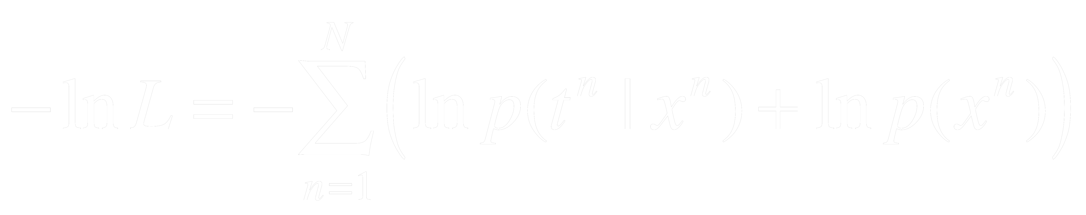
Modeling input-output data
In the previous slides, we just assumed one-dimensional data.
In applications of neural networks (and regression), we have inputs and outputs, i.e., now the likelihood looks like:
And taking the negative log, we get:

Slide 24
Modeling input-output data
Since we are modeling the mapping from x to t, when minimizing this with respect to our parameters, the second term doesn’t change, so we can drop it.

Slide 25
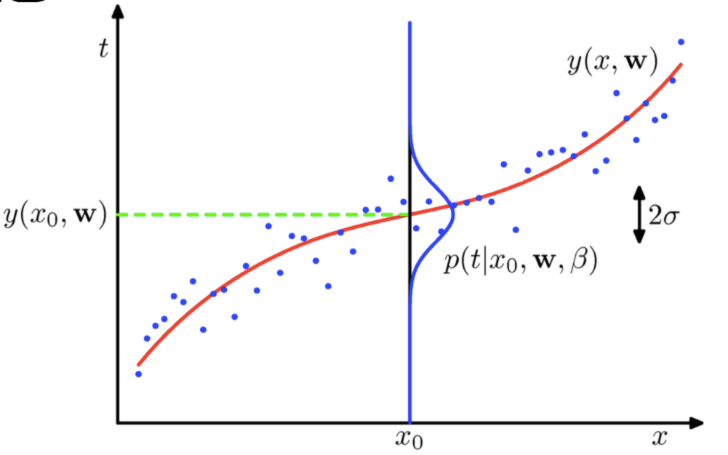
ML and regression
Main idea: Assume gaussian noise in the targets t^{n} (don’t take the expressions in the figure here too seriously – not in our notation!)

Slide 26
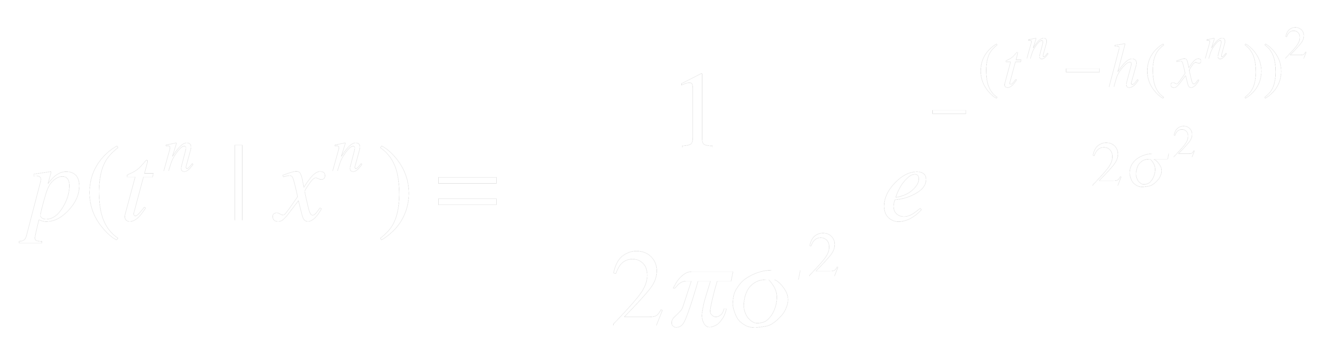
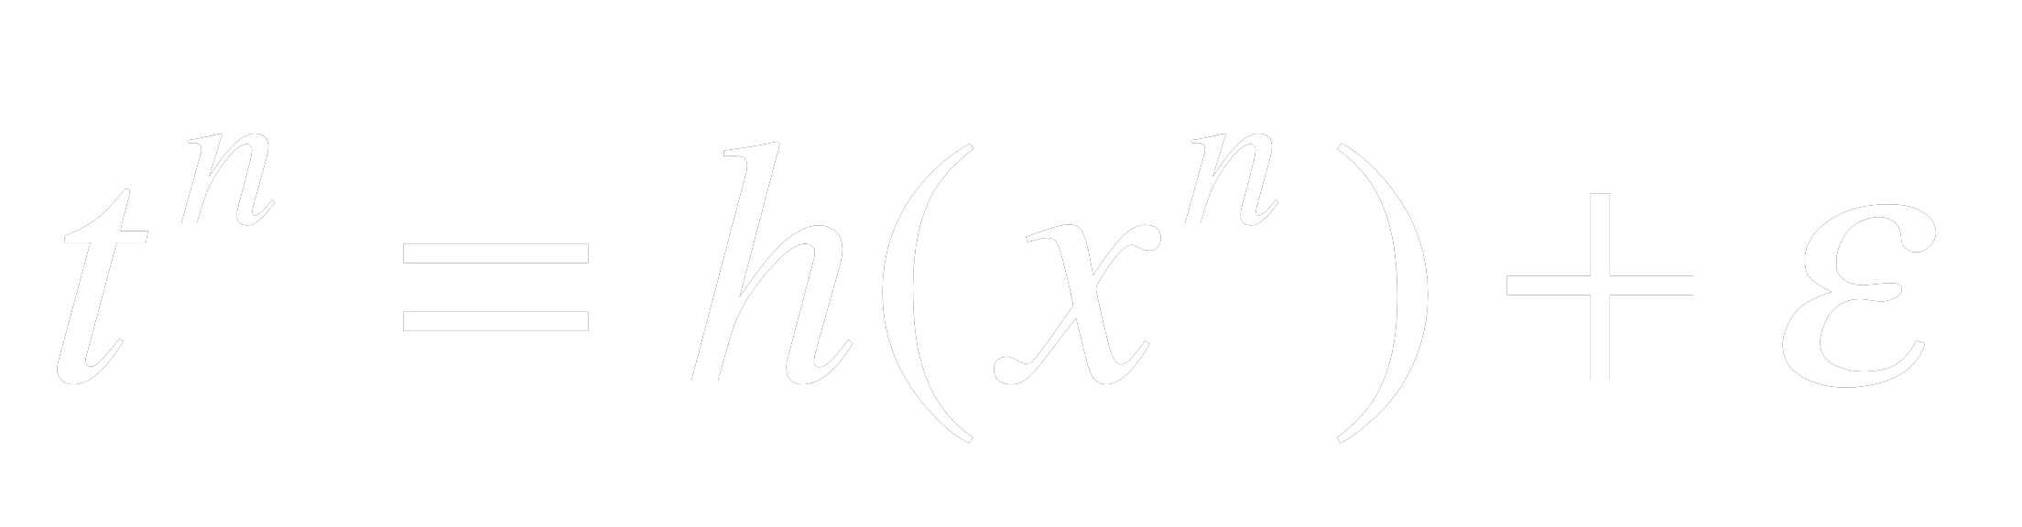

ML and regression
Main idea: Assume gaussian distribution of the targets
In other words:
Here, we assume that there is an underlying deterministic function h (the red line), with some additive, 0 mean gaussian noise ε:
or,

Slide 27
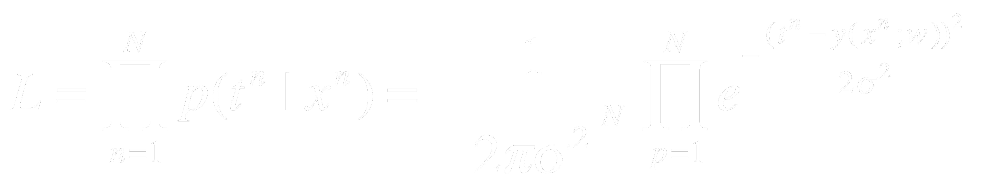
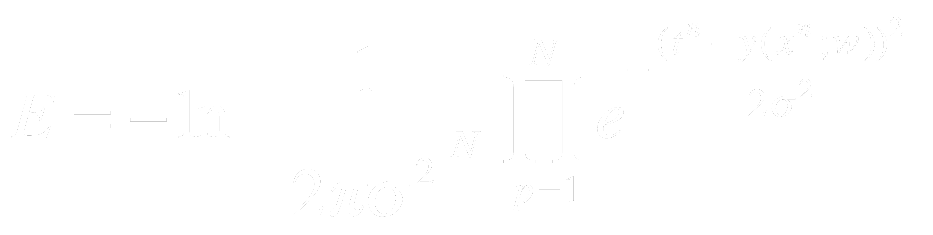
ML and regression
So, the likelihood of all of the data looks like:
Where we have replaced the deterministic function h(x^{n}) by our model of it, y(x^{n};w) (this notation emphasizes that the network is parameterized by the weights, w.)
And the negative log likelihood, or error is:

Slide 28
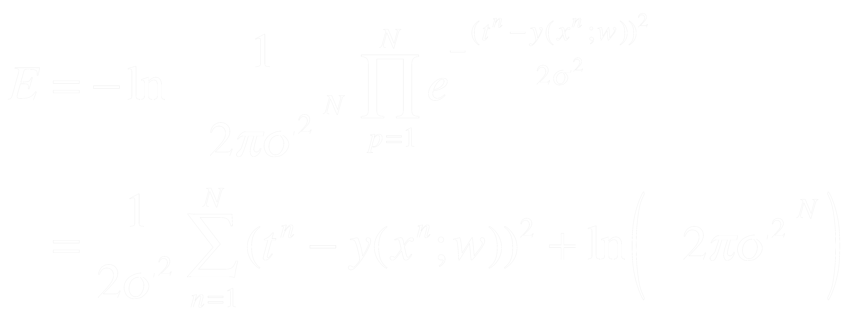
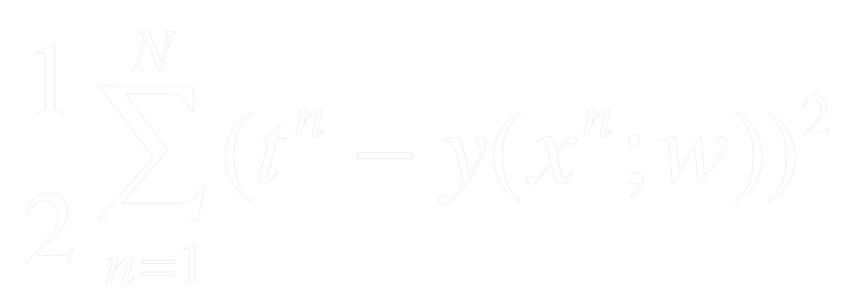
ML and regression
The negative log likelihood, or error is:
Removing the second term, which is constant with respect to the weights, and the factor of 1/σ², which doesn’t affect the minimum, we get:

Slide 29

ML and regression
To recap:
When doing regression, if we
assume the targets are Gaussian distributed, and
maximize the likelihood of the data by minimizing the negative log likelihood of the data,
We find that we need to minimize the Sum Squared Error!

Slide 30
This lecture
What is maximum likelihood?
How does it lead to Sum Squared Error for regression?
How does it lead to cross-entropy for logistic regression?
How does it lead to cross-entropy for multinomial regression?

Slide 31
Logistic regression should output the probability of category 1
Here, we want the network to produce the probability that the input is in category 1:
y(x^{n})=P(C₁|x^{n})
Note: This is basically categorization!

Slide 32
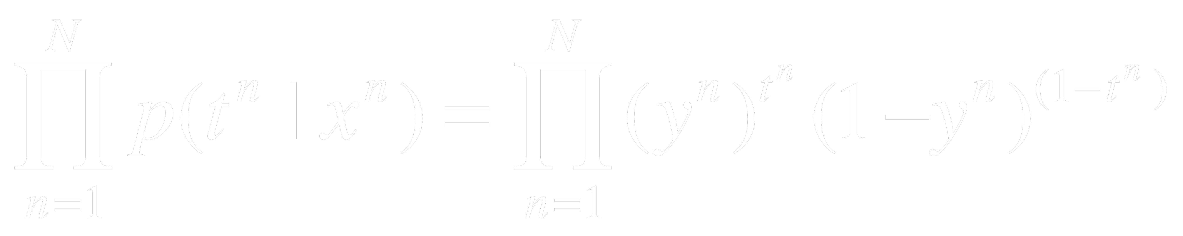
Modeling two categories is like modeling a coin flip
Here, we want the network to produce the probability that the input is in category 1:
y(x^{n})=P(C₁|x^{n})
This will work if we use t^{n} = 1 for category 1, and t^{n} = 0 for category 2.
What is the likelihood of the data now?
L =

Slide 33
Modeling two categories is like modeling a coin flip
What is the likelihood of the data now?
Again, the network is modeling the probability distribution of the data.
By assumption last time, it was a Gaussian distribution; now, it is a Bernoulli distribution (same as for a coin flip!).
L =

Slide 34
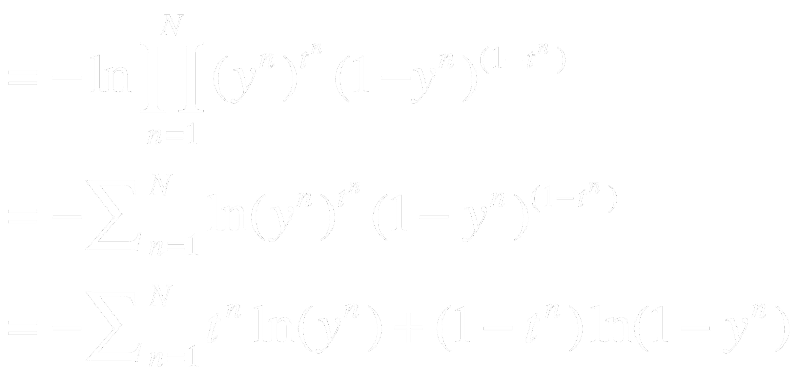
Modeling two categories is like modeling a coin flip
=
-ln L
Cross entropy error!

Slide 35
ML and two-category classification
To recap:
When doing two-category classification (AKA logistic regression), if we
assume the targets are Bernoulli distributed, and
maximize the likelihood of the data by minimizing the negative log likelihood,
we find that we need to minimize the Cross Entropy Error!

Slide 36
This lecture
What is maximum likelihood?
How does it lead to Sum Squared Error for regression?
How does it lead to cross-entropy for logistic regression?
How does it lead to cross-entropy for multinomial regression?

Slide 37
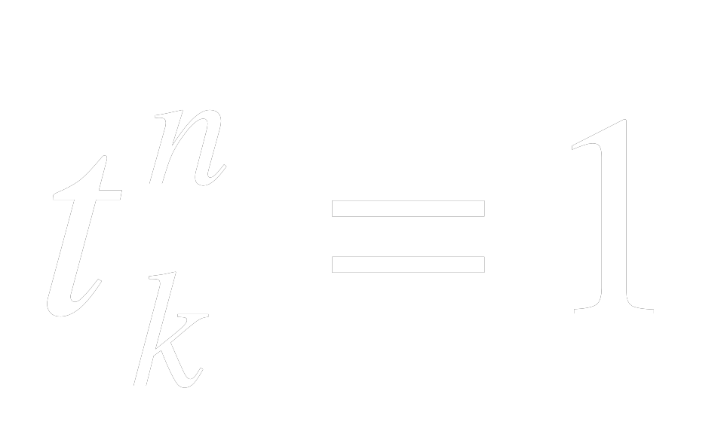
Multinomial Regression
Now we have more than two categories – so we need multiple outputs.
Let’s assume there are c outputs, one for each category.
Now we want: P(C_{k}|x^{n}) = y_{k}(x^{n}) – the k^{th} output is the probability that the input is in category k...
And if example n is from category k, and 0 otherwise (one hot encoding)
How to write the likelihood?

Slide 38
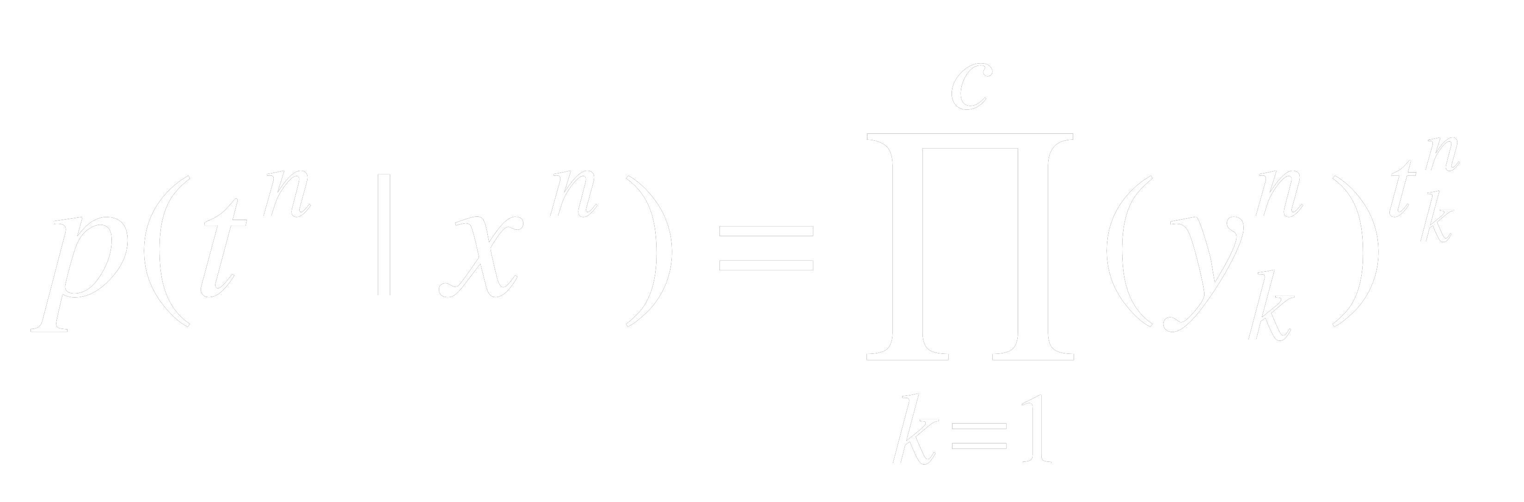
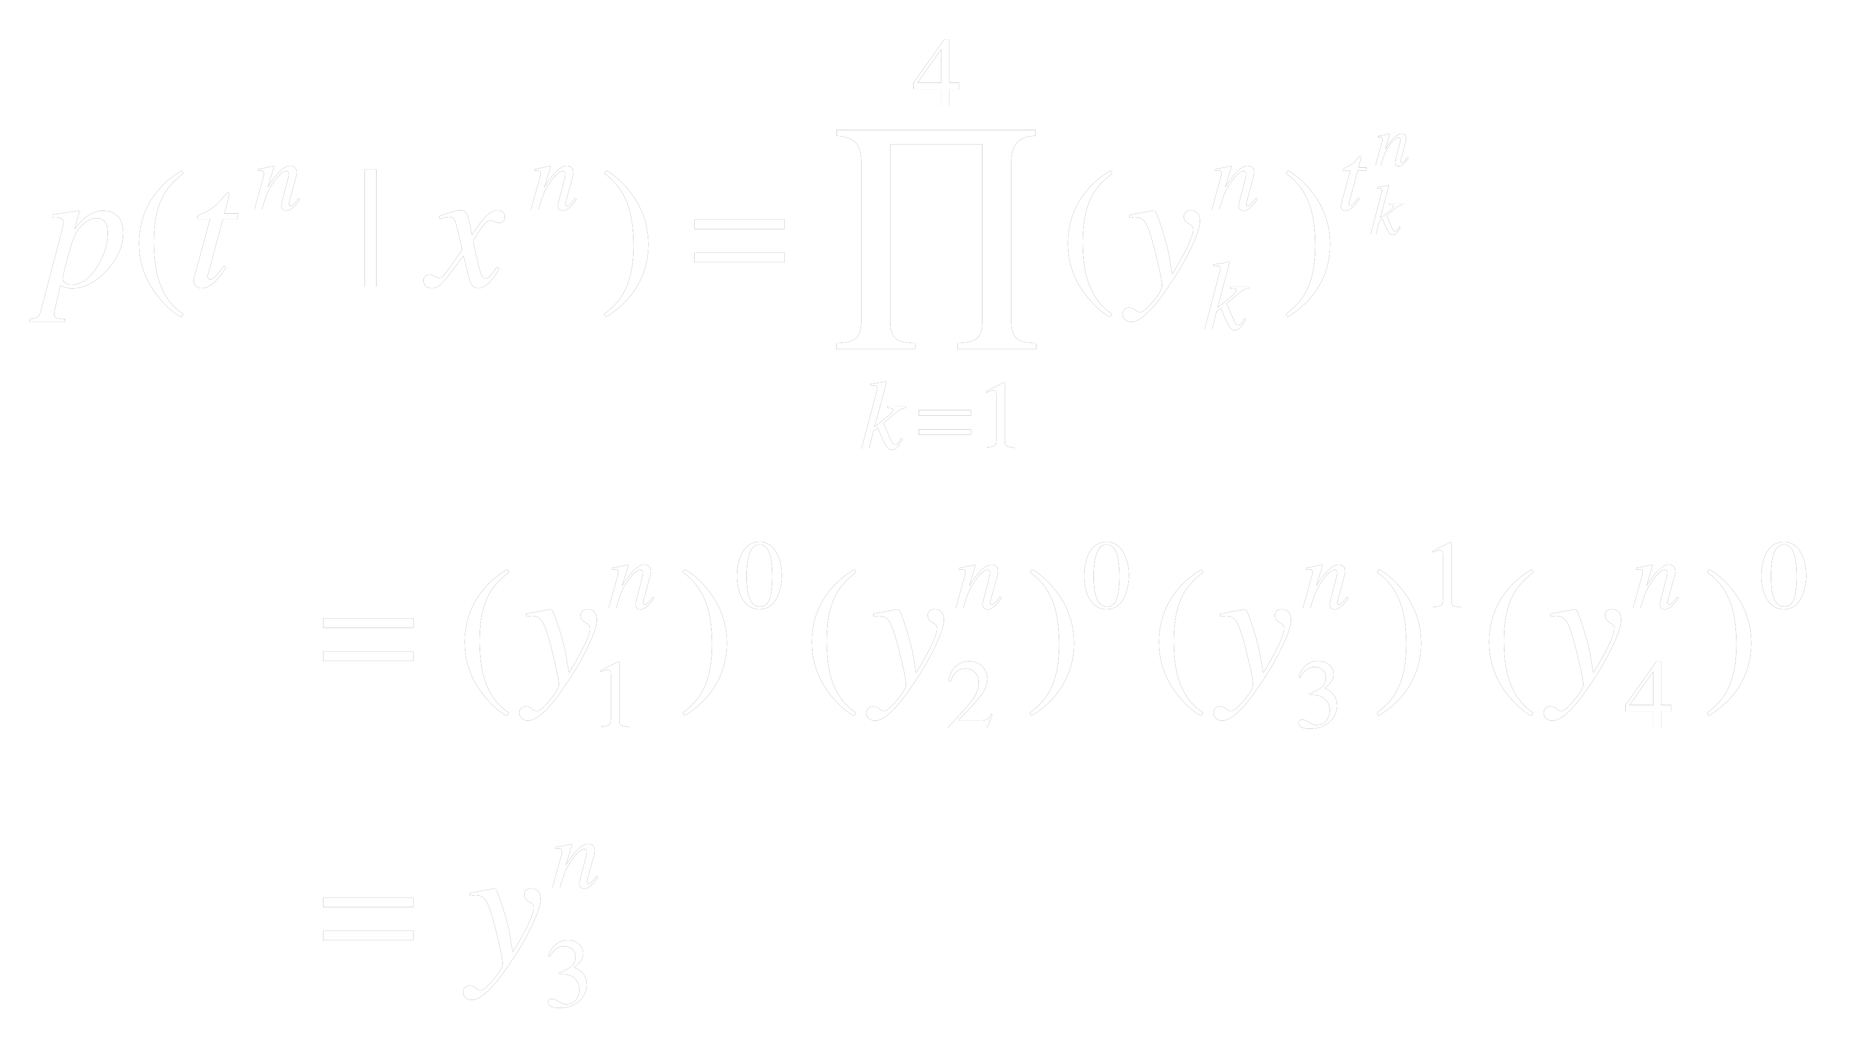
Multinomial Regression
Now: P(C_{k}|x^{n}) = y_{k}(x^{n}) and if example n is from category k, and 0 otherwise (one hot encoding)
We can therefore write the probability of one pattern as:
E.g., suppose the input is from category 3 out of 4 total categories. Then:

Slide 39
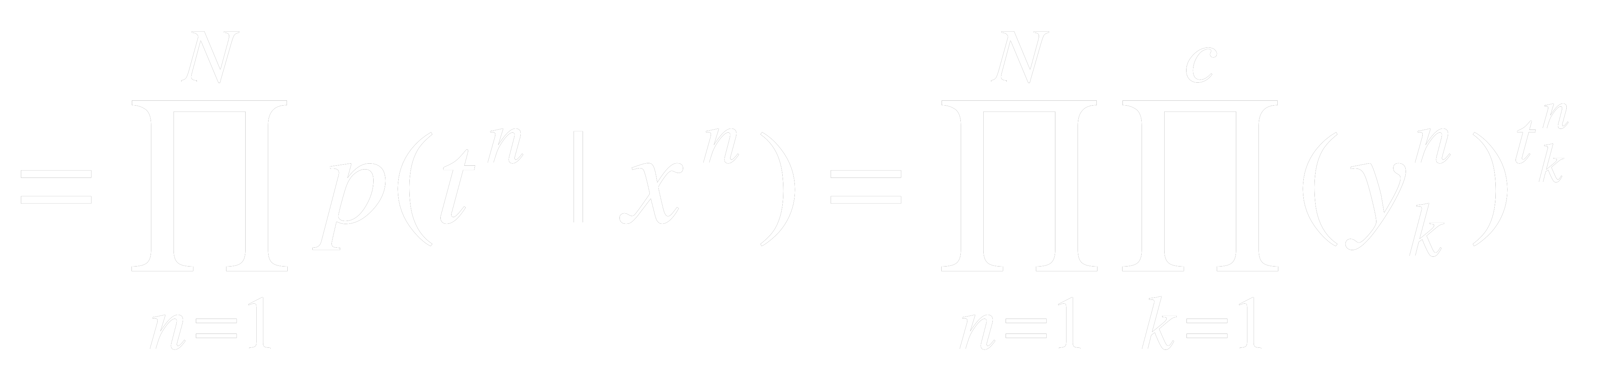
Multinomial Regression
Now: P(C_{k}|x^{n})=y_{k}(x^{n}) and if example n is from category k, and 0 otherwise (one hot encoding)
We can therefore write the probability of one pattern as:
So we can write the entire likelihood as:
L

Slide 40
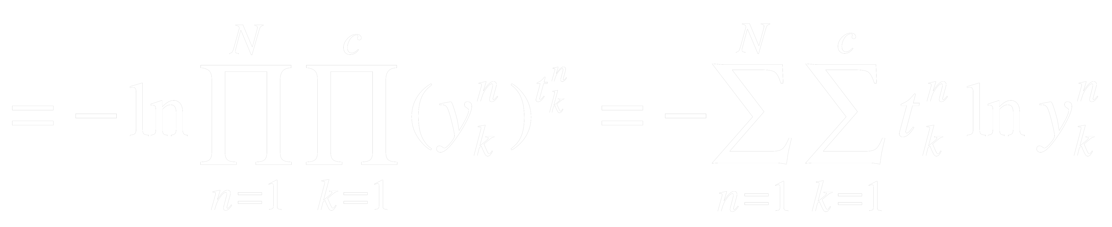
Multinomial Regression
So we can write the entire likelihood as:
L
And the negative log likelihood as:
-ln L

Slide 41
ML and c-way classification
To recap:
When doing c-way classification (AKA multinomial regression), if we
assume the targets are multinomially distributed, and
maximize the likelihood of the data by minimizing the negative log likelihood,
we find that we need to minimize the Cross Entropy Error!

Slide 42
Next lecture
What is maximum likelihood?
How does it lead to Sum Squared Error for regression?
How does it lead to cross-entropy for logistic regression?
How does it lead to cross-entropy for multinomial regression?
Other approaches to objective functions
Summary
Some tricks of the trade

Slide 43
Another approach to objective functions
Sometimes we aren’t trying to fit a distribution!
Suppose we have two networks, with output vectors of arbitrary but equal dimension – but their meaning is unspecified.
This output vector can represent some arbitrary transformation of the input vector.
E.g., we may want all pictures of the same person to have the same representation, while all pictures of different people to have different representations.

Slide 44
Another approach to objective functions
E.g., we may want all pictures of the same person to have the same representation, while all pictures of different people to have different representations.
This is clustering
For example, supposed we only knew some inputs are from the same category, and some inputs are from different categories.
The next slide is an example of the result of this using MNIST

Slide 45
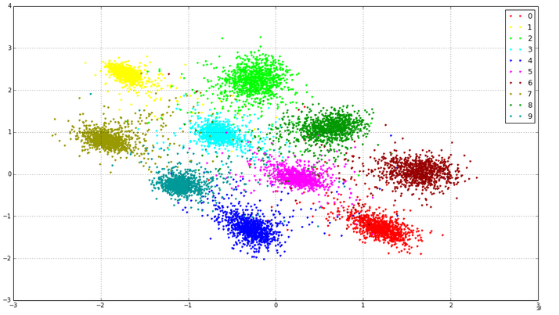
MNIST clusters in 2 dimensions (the network has two outputs)

Slide 46
What kind of objective function could we use?
We want representations of things from the same category to be pushed together, and representations of things from different categories to be pushed apart.
We could take the two outputs, and minimize the distance between them when they are the same (using, e.g., squared error), and put a negative sign on that when they are different (push them apart).
But other ways to “push them apart” are possible.
These kinds of objective functions are sometimes called energy functions.
We will see more of this later in the quarter.

Slide 47
Summary
Maximum Likelihood is a kind of “meta-objective” function:
overall, you want to adjust your parameters to maximize the likelihood of the data you see.
But the particular form of the function you get varies with the kind of distribution you are modeling
A gaussian distribution leads to SSE
A bernoulli distribution leads to cross entropy
A multinomial distribution, with the right target coding, leads to cross entropy.
Other kinds of objective functions are possible, depending on what you are trying to do.

